Slide 1











SCENARIO 1

Slide 2





INCIDENT RESPONSE
The goal of an effective information security incident management strategy is a balance of driving the impact of the incidents down, while processing incidents as efficiently as possible. Good incident management will also help with the prevention of future incidents.
CSIRT
Is the Computer Security Incident Response Team that provides Services to the company to which it belongs. It also supports and coordinates among the different branches the treatment of Incidents related to IT security.

Slide 3
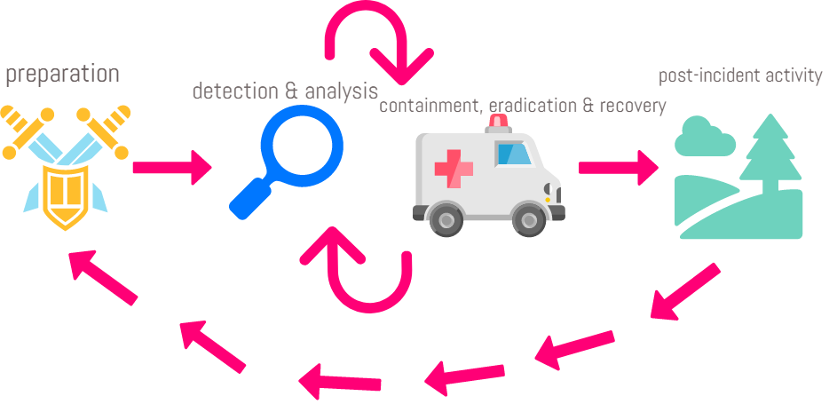
INCIDENT LIFE CYCLE NIST, in their 800-61 Computer Security Incident Handling Guide, describes the "Incident Lifecycle"

Slide 4


PREPARATION
Involves identification of resources needed for incident handling and having trained individuals ready to respond by developing and communicating a formal detection and reporting process.
DETECTION AND REPORTING
Designing an effective means of the detection of incidents is also essential, using both trained users and trained system administrators, and various technical controls.
CONTAINMENT, ERADICATION & RECOVERY
Containment is important before an incident overwhelms resources or increases damage. Containment provides time for developing a tailored remediation strategy. Eradication may be necessary to eliminate components of the incident. In recovery, administrators restore systems to normal operation.
POST-INCIDENTACTIVITY
One of the most important parts of incident response is also the most often omitted: learning and improving . Multiple incidents can be covered in a single lessons learned meeting. This meeting provides a chance to achieve closure with respect to an incident by reviewing what occurred, what was done to intervene, and how well intervention worked.

Slide 5
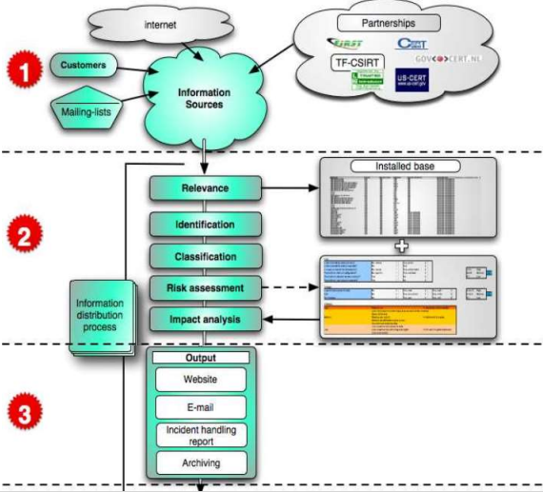
CSIRT’S INCIDENT TRAITMENT

Slide 6

STEP 1 Gathering Incident Information
The incident reports arrive at the CSIRT by different channels. It is good practice to write down all the details in a format while receiving the incident notice.
STEP 2 Evaluation of information and risk assessment
In order to evaluate the incident there are some categories to take into account:
Identification:
In order to avoid unnecessary actions, it is important to check that the creator of the report is reliable and belongs to the group of clients served by an associated CSIRT.
Relevance:
This step checks whether the incident handling request comes from the client group served by the CSIRT, or if the reported incident affects IT systems of the group being served. If this is not the case, the communication is usually sent to the relevant CSIRT.
Classification:
In this step the incident it’s classified according to its gravity.
STEP 3 Distribution
The incident should be reported.

Slide 7
On a Saturday afternoon, external users start having problems accessing the organization’s public websites.
Over the next hour, the problem worsens to the point where nearly every access attempt fails. Meanwhile, a member of the organization’s networking staff responds to alerts from an Internet border router and determines that the organization’s Internet bandwidth is being consumed by an unusually large volume of User Datagram Protocol (UDP) packets to and from both the organization’s public DNS servers.
Analysis of the traffic shows that the DNS servers are receiving high volumes of requests from a single external IP address. Also, all the DNS requests from that address come from the same source port.
SCENARIO 1

Slide 8


PREPARATION / STEP 1
*Would the organization consider this activity to be an incident? If so, which of the organization’s policies does this activity violate?
--Monitoring: Critical systems must be under permanent monitoring.
--Web-sites: Access to web pages through browsers must be subject to the rules that are previously stated in the Regulation of access to the Network. The website should be 24/7 up , the amount of time before it turns into an incident to be reported is 1 minute.
--About services provided: All the services that are given must be listed and monitored whenever a request is made, keeping data of: time, date, information accessed, modifications made.
-About the equipment's personal: It is the responsibility of the Department of Networks to disclose the lists of persons who may have access to the equipment and provide basic maintenance. Technical personnel in case of incidents most be available 24/7.
-Incidents: Any description of a computer incident should be kept for further analysis and improvement.

Slide 9
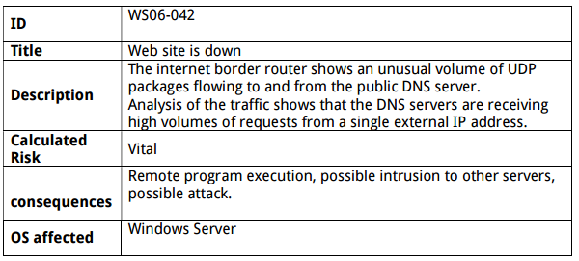
Receiving incident report

Slide 10

DETECTION AND ANALYSIS / STEP 1
*What precursors of the incident, if any, might the organization detect?
-Web server log entries that show the usage of a vulnerability scanner
-Network capacity tool predicts a big transit of packages coming.
-Network capacity tool predicts improvements needed in the network architecture for further applications.
-Software notice of new update available.
-Antivirus software denies entry from unknown sources
*What indicators of the incident might the organization detect?
-An application registers multiple failed login attempts from an unfamiliar remote system.
-Antivirus software triggered alerts of unidentified packages coming.
-A member of the organization’s networking staff responds to alerts from a Internet border router.
-An unusual large volume of UDP packets are found.
-Internet bandwidth is being consume rapidly.

Slide 11
*To which people and groups within the organization would the team report the incident? -CIO -Head of information security -Systems owners -The management group(In order to report the incident and stablish the response policy for this kind of incidents) -IT head leader and support team -Information Assurance team (In case we need to alter secure controls such as firewalls, privileges, passwords etc.) -Business Continuity Planning team (To ensure that incident response policies and procedures and business continuity processes are coordinated)

Slide 12
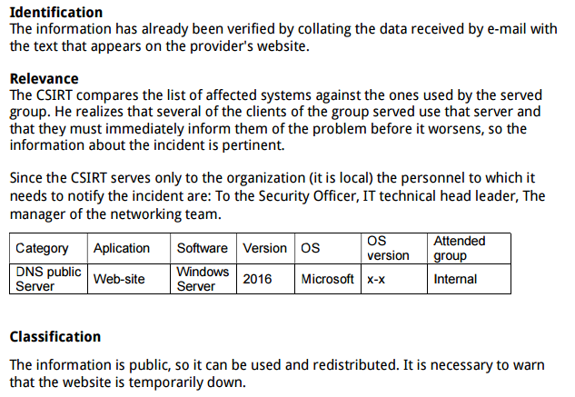
How would the incident response team analyze and validate this incident?

Slide 13
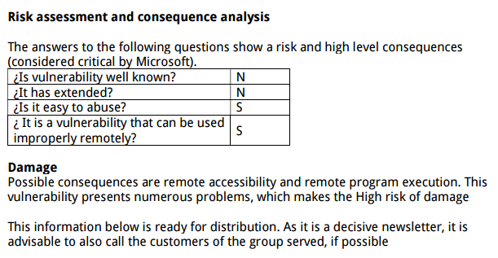
How would the incident response team analyze and validate this incident?

Slide 14



CONTAINMENT, ERADICATION & RECOVERY / STEP 2
*What strategy should the organization take to contain the incident?
-The sandboxing is preferable over the other strategy because this helps to make more time while this incident is being reviewed in case of turn into something more than a big number of requests to broke down the website.
*What could happen if the incident were not contained?
-Lost the DNS server integrity.
-External programs could have entered to the network to install scripts to be executed for stealing, corrupting or destroying important information.
-These scenarios could have happened not only to the DNS server so is to the rest of the entities connected to the organization’s network

Slide 15
*Which personnel would be involved in the containment, eradication, and/or recovery processes?
-Legal Department
-Public Affairs and Media Relations
-Human resources
-Information Security Officer
-The manager of the incident group.
-The manager of the networking team.
-The technical lead.
-The Incident lead.
-The POC for external parties affected
-The networking staff

Slide 16
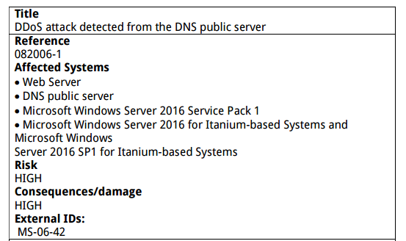
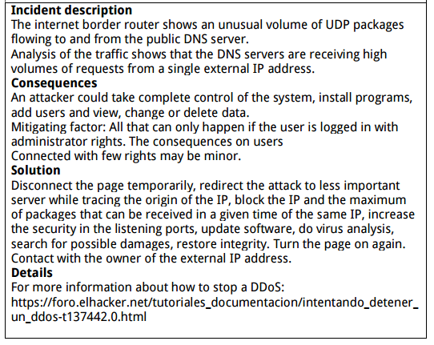
Incident report distribution

Slide 17


POST-INCIDENT ACTIVITY / STEP 3
*Who would attend the lessons learned meeting regarding this incident?
Personnel of the CSIRT:
• General Director
• Manager of the CSIRT
• Communications Adviser
• Legal Adviser
• Researchers
Others:
*CIO
*Security Officer
*Head of the technical team
*Head of the network team
*The POC with external parties involved

Slide 18



*What could be done to prevent similar incidents from occurring in the future?
-*Improve the security inside the DNS server, such as to restrict the ports being used and change to others that hasn’t being used before.
*Implement validation tools more restrictive.
*Change the way the personnel roles on weekends, probably using home office to have them before the indicator fires.
*Get a special server to be used as bait, for containment strategies.
*Have a list of contacts of trust will come handy if someone is not available.
*Implementing more strategies of monitoring and prediction of network traffic.
*Mitigate vulnerabilities

Slide 19

*To which external parties would the team report the incident?
-The external parties identified here are:
*Media such as users of the website
* Mexico:
In means of law enforcements agencies, we need a POC with the Federal Institute of Access to Public Information INAI, other organizations may be the Internet service providers ISPs, the owners of Attacking Addresses, Software Vendors and affected external parties in general.
*USA
Agencies in USA are FBI, US-CERT and ISACs, Internet service providers (ISPs), owners of Attacking Addresses, Software Vendors and affected external parties in general.

Slide 20

CONCLUSION
Incident management is a very powerful tool for the development of the company.

